Slide 1
Making A Simple API project using GrpahQL with .Net 7
Presented By : Yin Win Phyu

Slide 2

Table of contents
01
About GraphQL
02
Navigating API Choices
The Easy and Simple Library for GraphQL
03
Types of GraphQL
04
Simple API Project By GraphQL
05

Slide 3

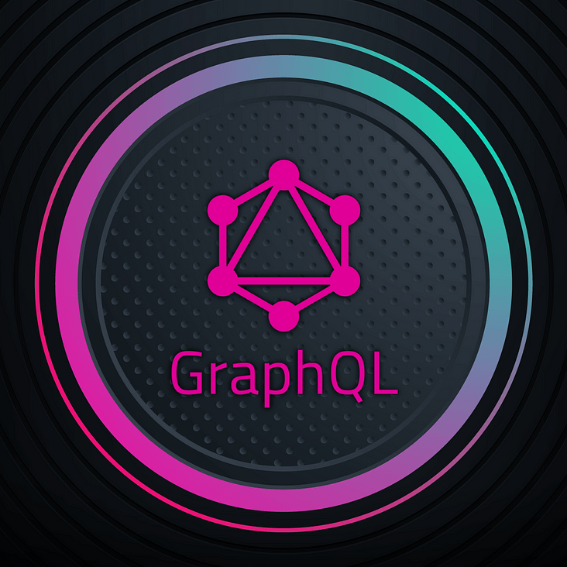

01
About GraphQL

Slide 4
About GraphQL
GraphQL is a query language for APIs and a runtime for executing those queries by using a type system you define for your data. It provides a more efficient, powerful, and flexible alternative to REST for accessing data in an API.

Slide 5
02
Navigating API Choices

Slide 6
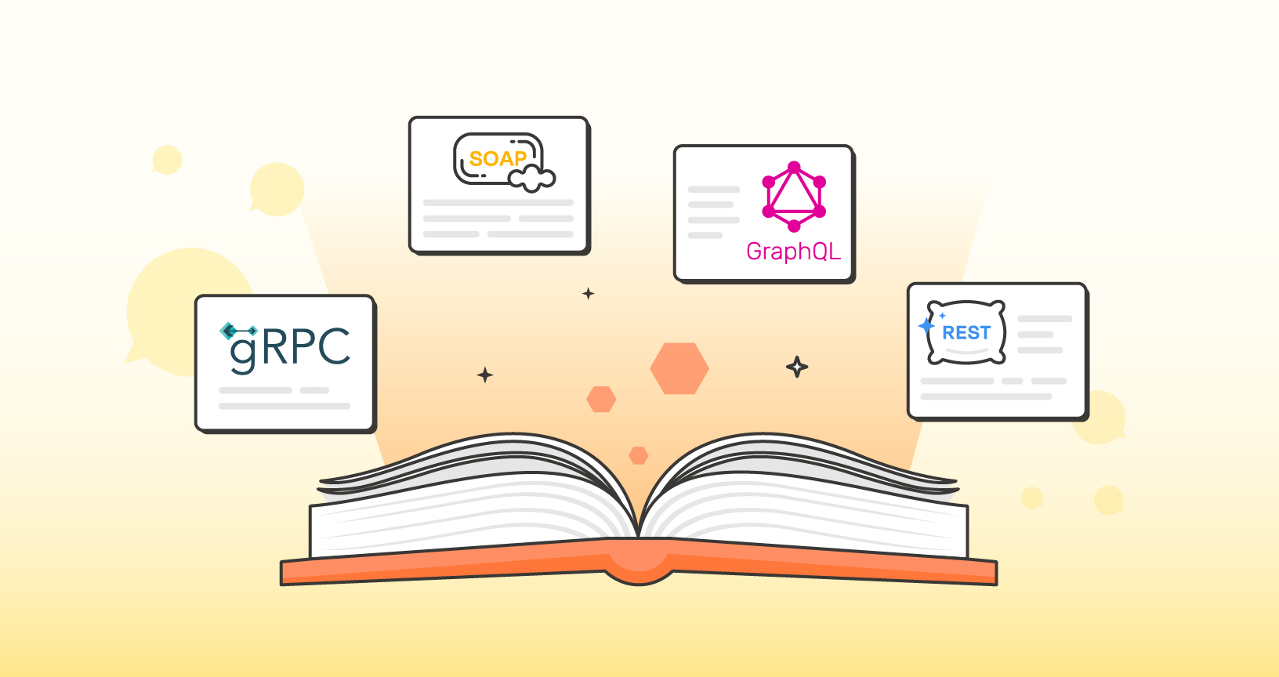
Navigating API Choices

Slide 7
1. GraphQL
Overview GraphQL is a query language for APIs Key Features Flexible Queries: Clients specify exactly what data they need. Single Endpoint: Uses a single endpoint to handle all requests. Strongly Typed Schema: Schema defines types and relationships. Introspective: Clients can query the schema itself. Real-time Capabilities: Supports subscriptions for real-time updates.

Slide 8
1. GraphQL
Pros Efficient data fetching: Only the data requested by the client is returned. Strongly typed schema ensures valid queries. Reduces over-fetching and under-fetching of data. Cons Can be complex to implement and optimize. Requires learning a new query language. May lead to deeply nested queries that are hard to optimize.

Slide 9
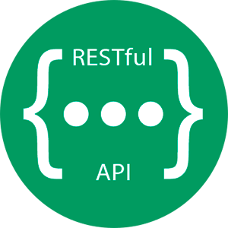
2. REST API
Overview architectural style for designing networked applications. Uses standard HTTP methods Key Features Resource-Based: Everything is a resource accessible via a unique URL. Stateless: Each request from the client contains all the information needed to process the request. Cacheable: Responses must define themselves as cacheable or non-cacheable.

Slide 10
2. REST API
Pros Simple and widely understood. Leverages existing HTTP infrastructure. Easy to test with standard tools like Postman. Cons Can lead to over-fetching or under-fetching of data. Multiple endpoints can lead to complex client logic. Lacks a standard way to describe APIs (though OpenAPI helps).

Slide 11
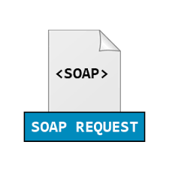
3. SOAP
Overview a protocol for exchanging structured information in web services. Uses XML for message Key Features Extensive Standards: Built-in error handling, security (WS-Security), and transaction compliance. Strong Typing: Uses WSDL (Web Services Description Language) to describe services. Stateful Operations: Supports complex operations and stateful interactions.

Slide 12
3. SOAP
Pros Highly extensible and standardized. Built-in error handling and security features. Suitable for enterprise-level applications requiring high security. Cons Verbose XML format increases bandwidth usage. Steeper learning curve and complexity. Can be slower due to larger message sizes.

Slide 13
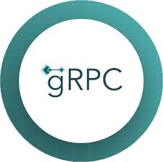
4. gRPC
Overview open-source remote procedure call system developed by Google. Uses Protocol Buffers (protobuf) as the interface definition language. Key Features High Performance: Efficient binary serialization. Bi-Directional Streaming: Supports client, server, and bi-directional streaming. Strongly Typed: Interface defined using Protocol Buffers. Supports Multiple Languages: Provides language-specific bindings.

Slide 14
4. gRPC
Pros High performance and low latency. Strongly typed contracts with Protocol Buffers. Supports advanced use cases like bi-directional streaming. Cons Requires additional tooling (e.g., protoc compiler for protobuf). Not as human-readable as JSON (used in REST). Learning curve for Protocol Buffers and gRPC concepts.

Slide 15
03
Types of GraphQL

Slide 16
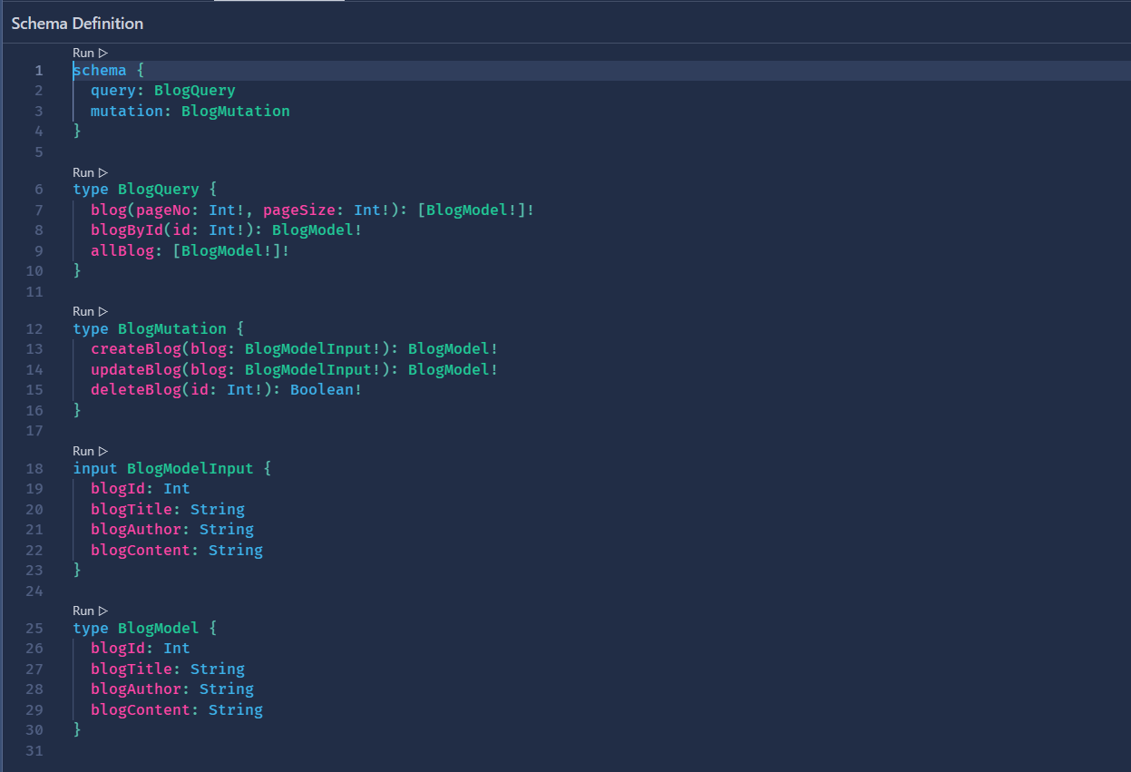
Types of GraphQL

Slide 17
04
The Easy and Simple Library for GraphQL

Slide 18

The Easy and Simple Library for GraphQL
Hot Chocolate is a .NET GraphQL server library allows you to create a GraphQL API quickly and efficiently provides tools for building robust GraphQL schemas and resolving queries and mutations, simplifying the process of integrating GraphQL into .NET applications. Banana Cake Pop is a GraphQL IDE that comes with the Hot Chocolate framework. provides a user-friendly interface for exploring and testing your GraphQL APIs, similar to GraphQL Playground or GraphiQL, but specifically tailored for use with Hot Chocolate.

Slide 19
05
Simple API Project By GraphQL

Slide 20
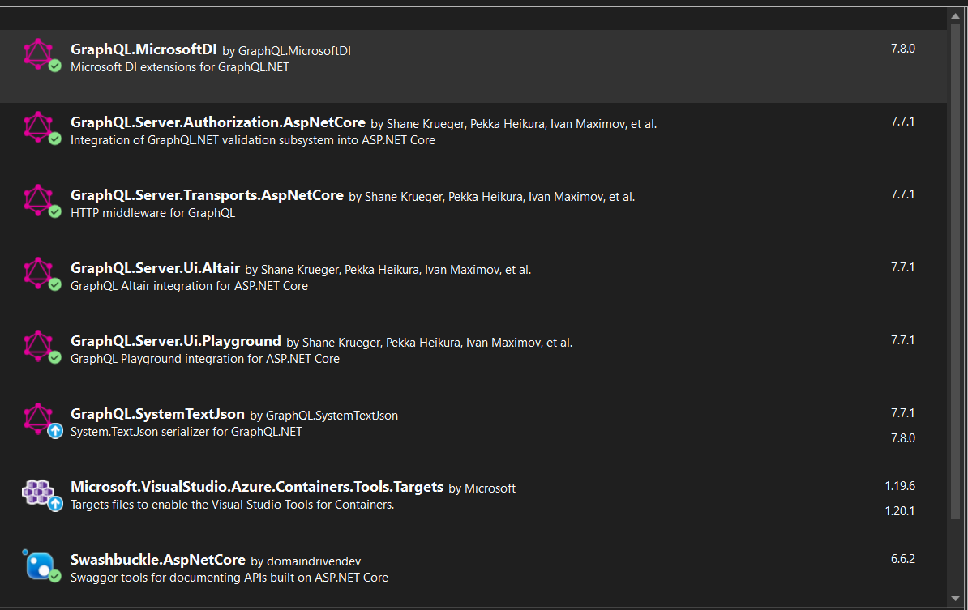
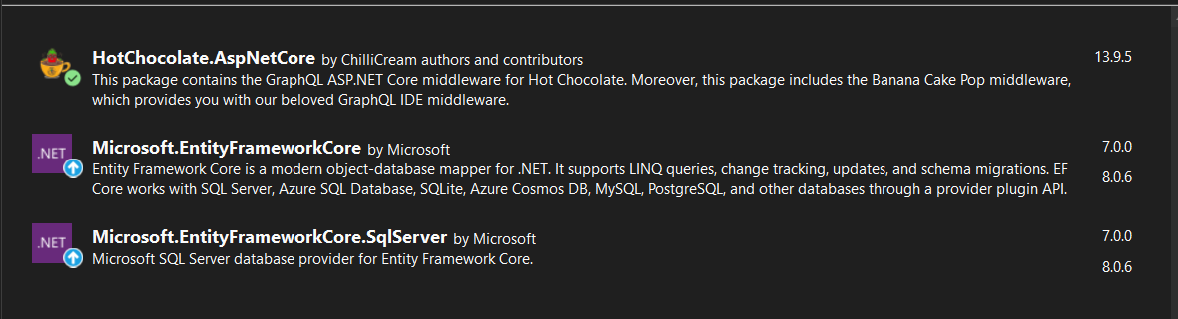
Simple API Project By GraphQL
The Libraires that need to install not using Hot Chocolate
The Libraires that need to install using Hot Chocolate

Slide 21
Simple API Project By GraphQL
Showing Code Time

Slide 22
